Slide 1
What’s the Opposite of Bullying?
By Dr. Lisa Coyne
Harvard Medical School/McLean & Suffolk University

Slide 2
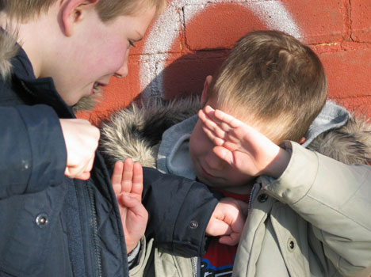
What does it mean to “bully?”

Slide 3
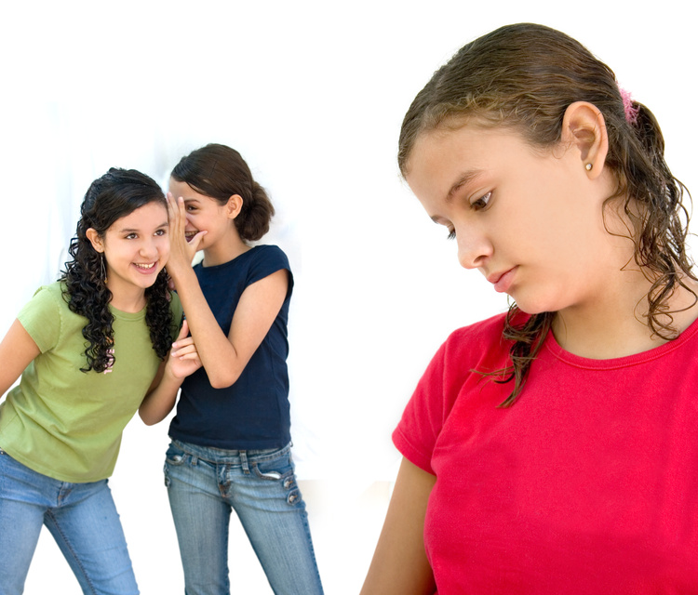

Slide 4
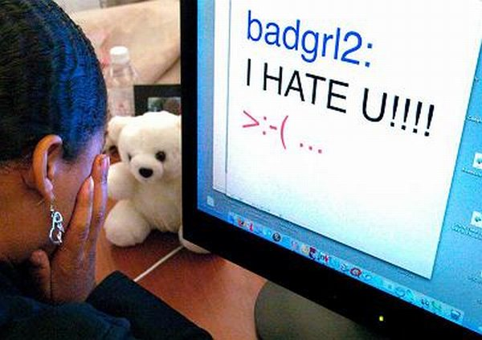

Slide 6
Who Gets Bullied?
1 in 5 kids –pushed, hit, knocked down
1 in 4 kids with disabilities, chronic
1 in 2 kids – with words or getting left out
1 in 10 kids – on the internet
Boys act differently than girls
Parents can help!

Slide 7
What Else Can I do?
Stand up
for your friends!

Slide 8
What Can I Do?
“Stand and Say ‘And’ ” Strategy

Slide 9
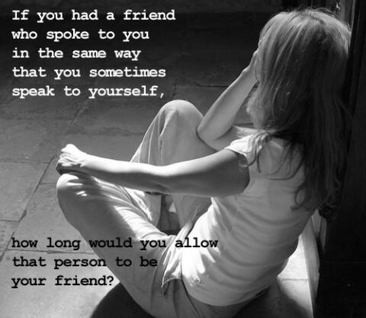
Sometimes we feel bullied by our thoughts and feelings

Slide 10
So…Nevermind your Mind!

Slide 11
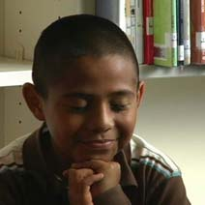
The Still, Quiet Place
Notes:
2. Emotion Adventurers:
Still Quiet Place (A Mindfulness exercise by Amy Salzman, 2008)
I would like to share one of my favorite places with you. I call it the Still Quiet Place. It’s not a place you travel in a car, train, or plane. It’s a place inside you that you can find by just closing your eyes.
Close your eyes and take some slow, deep breaths. See if you can feel a kind of warm, happy, smile in your body. Do you feel it? That is your Still Quiet Place. Take some more deep, slow breaths and really snuggle in.
The best thing about your Still Quiet Place is that it’s always inside you. And you can visit it whenever you like. It is nice to visit your Still Quiet Place and feel the love that is there. It is especially helpful to visit your Still Quiet Place if you are feeling angry, or sad, or afraid. The Still Quiet Place is a good place to talk with these feelings and make friends with them. When you are in your Still Quiet Place and talk to your feelings, you may find that your feelings are not as big and powerful as they seem. Remember that you can come here whenever you like, and stay for as long as you want.

Slide 12
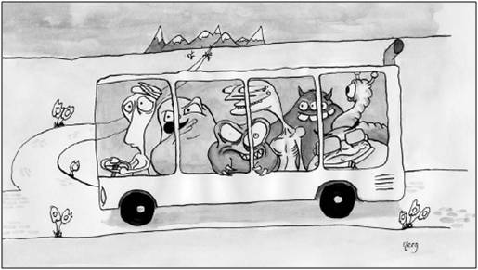
The Passengers on the Bus Game

Slide 13
What’s the Opposite of Bullying?

Slide 14
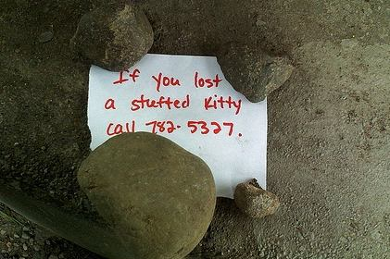
Kindness
Notes:
It is kindness in action; Awareness of shared human experience. -John Forsyth
Three components

Slide 15
The 3 parts of kindness

Slide 16
Notice when others are sad, or left out
Be kind, for everyone you meet
is fighting a hard battle.
-Plato

Slide 17
Share Sadness with Others
Notes:
Old French - Compassio = Sympathy, Pity
From Late Latin compassionem
Com = “together” + Pati “to suffer”
Or, to “suffer with”
Sympathetic consciousness of others’

Slide 18
Know that everyone does dumb stuff sometimes. That’s what connects us all together.
Notes:
Failure is human. That which is most personal is most universal. If I had a book…

Slide 19
What does it feel like to be kind?

Slide 20
Notes:
Practicing unconditional kindness. What if we reacted to any behavior towards us with unconditional kindness? Zen Koan of the thief.
Ryokan, a Zen master, lived the simplest kind of life in a little hut at the foot of a mountain. One evening a thief visited the hut only to discover there was nothing to steal.
Ryokan returned and caught him. "You have come a long way to visit me," he told the prowler, "and you should not return empty-handed. Please take my clothes as a gift."
The thief was bewildered. He took the clothes and slunk away.
Ryoken sat naked, watching the moon. "Poor fellow," he mused, "I wish I could have given him this beautiful moon."
What might the implications of that be?
Fowler & Christakis, 2009 paper on cooperative behavior cascade
We show that, in both an ordinary public goods
game and in a public goods game with punishment, focal individuals
are influenced by fellow group members’ contribution behavior in
future interactions with other individuals who were not a party to
The initial interaction. Furthermore, this influence persists for multiple
Periods and spreads up to three degrees of separation (from person to
person to person to person). The results suggest that each additional
contribution a subject makes to the public good in the first period is
tripled over the course of the experiment by other subjects who are
directly or indirectly influenced to contribute more as a consequence.
These results show experimentally that cooperative behavior cascades
in human social networks.

Slide 21
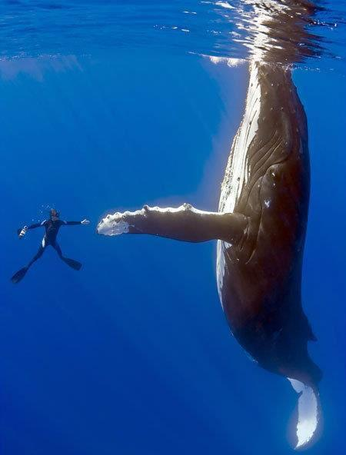
When she was free, the divers say
she swam in what seemed like
joyous circles. She then came back
to each and every diver, one at a time,
and nudged them, pushed them
gently around as she was thanking them. Some said it was the most
incredibly beautiful experience
of their lives. The guy who cut the rope
out of her mouth said her eyes were
following him the whole time, and he
will never be the same.
Notes:
Recent headline of the San Francisco Chronicle.
Female humpback whale who had become entangled
in a spiderweb of crab traps and line weighted down
by hundreds of pounds of traps that caused her
to struggle to stay afloat. She also had hundreds
of yards of line rope wrapped around her body, tail,
Torso, and a line tugging in her mouth. A fisherman spotted her just east of the Farallon Islands
and radioed an environmental group for help.
Within a few hours, the rescue team arrived
and determined that she was so bad off,
the only way to save her was to dive in
and untangle her. They worked for hours
and eventually freed her.

Slide 23
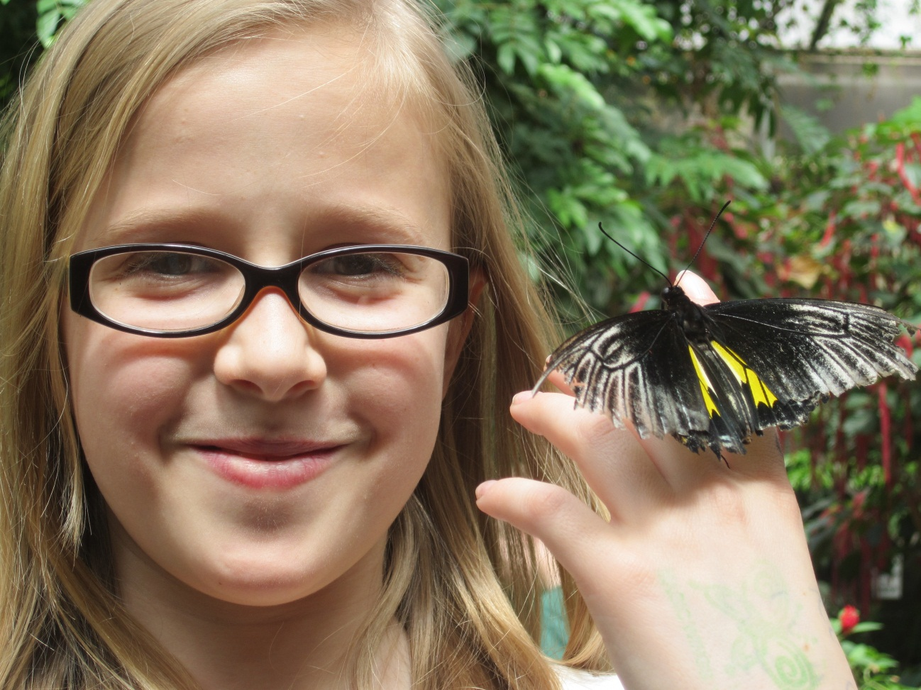
Thanks!
For slides, please contact:
Lisa W. Coyne, Ph.D
Psychology Department
Suffolk University
41 Temple Street
Boston MA 02114
(617) 305-6363
Email: lcoyne@suffolk.edu
Website: www.suffolk.edu

Slide 24
For Parents, teachers, & school administrators

Slide 25
Who Gets Bullied?
Prevalence rates of having bullied others or having been bullied at school for at least once in the last 2 months were 20.8% physically, 53.6% verbally, 51.4% socially, or 13.6% electronically. Boys were more involved in physical or verbal bullying, whereas girls were more involved in relational bullying. Boys were more likely to be cyber bullies, whereas girls were more likely to be cyber victims. African-American adolescents were involved in more bullying (physical, verbal, or cyber) but less victimization (verbal or relational). Higher parental support was associated with less involvement across all forms and classifications of bullying. Having more friends was associated with more bullying and less victimization for physical, verbal, and relational forms but was not associated with cyber bullying.
J Adolesc Health. 2009 Oct;45(4):368-75. doi: 10.1016/j.jadohealth.2009.03.021. E
pub 2009 Jun 11. School bullying among adolescents in the United States: physical, verbal,
relational, and cyber. Wang J, Iannotti RJ, Nansel TR.

Slide 26
Students with Disabilities
This study examined the prevalence rates of bully victimization and risk for repeated victimization among students with disabilities using the Special Education Elementary Longitudinal Study and the National Longitudinal Transition Study-2 longitudinal datasets. Results revealed that a prevalence rate ranging from 24.5% in elementary school to 34.1% in middle school. This is one to one and a half times the national average for students without disabilities. The rate of bully victimization was highest for students with emotional disturbance across school levels. Findings from this study also indicated that students with disabilities who were bullied once were at high risk of being bullied repeatedly. Elementary and middle school students with autism and high school students with orthopedic impairments were at the greatest risk of experiencing repeated victimization.
National prevalence rates of bully victimization among students
with disabilities in the United States. Blake, Jamilia J.; Lund, Emily M.;
Zhou, Qiong; Kwok, Oi-man; Benz, Michael R., School Psychology Quarterly, Vol 27(4),

Slide 27
Sexual Minority Youth
A new study conducted by doctors at Nationwide Children's Hospital found that sexual minority youth, or teens that identify themselves as gay, lesbian or bisexual, are bullied two to three times more than heterosexuals.
According to the study that is now available online in the Journal of Adolescent Health, sexual minority youth are more vulnerable to a variety of physical and mental domains such as bullying or suicidal thoughts. Plus, the study found that many older adolescents reported being bullied.
Nationwide Children's Hospital (2010, February 1). Sexual minority youth
bullied more than heterosexual youth. ScienceDaily.

Slide 28
References & Resources for Parents, Teachers, and School Administrators
National prevalence rates of bully victimization among students with disabilities in the United States. Blake, Jamilia J.; Lund, Emily M.; Zhou, Qiong; Kwok, Oi-man; Benz, Michael R., School Psychology Quarterly, Vol 27(4),
J Adolesc Health. 2009 Oct;45(4):368-75. doi: 10.1016/j.jadohealth.2009.03.021. Epub 2009 Jun 11. School bullying among adolescents in the United States: physical, verbal, relational, and cyber. Wang J, Iannotti RJ, Nansel TR.
http://www.promoteprevent.org/publications/ebi-factsheets/olweus-bullying-prevention-program
http://webhost.bridgew.edu/marc/
Nationwide Children's Hospital (2010, February 1). Sexual minority youth bullied more than heterosexual youth. ScienceDaily.

